Slide 1
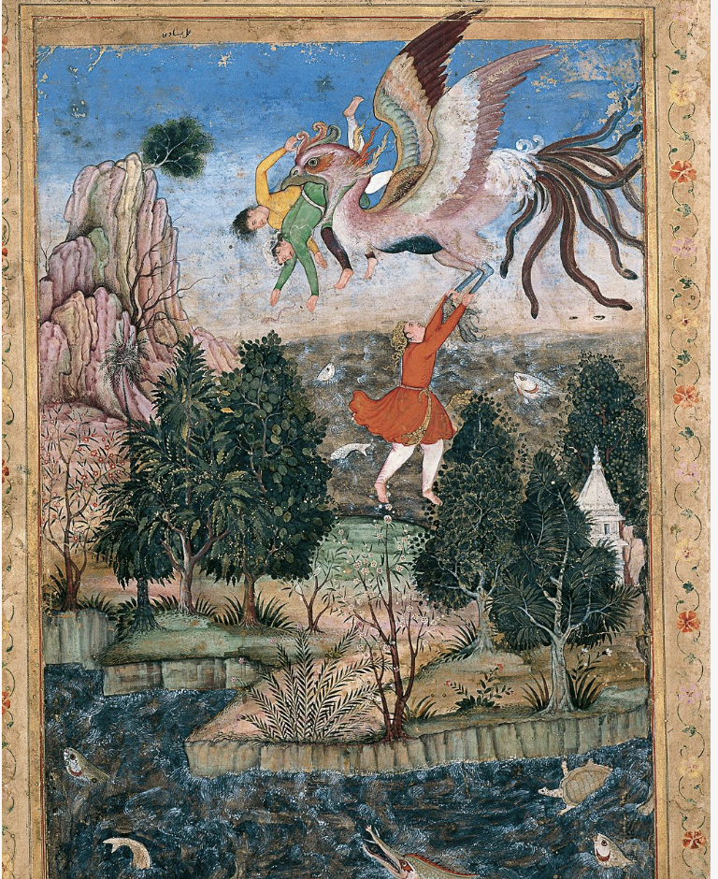
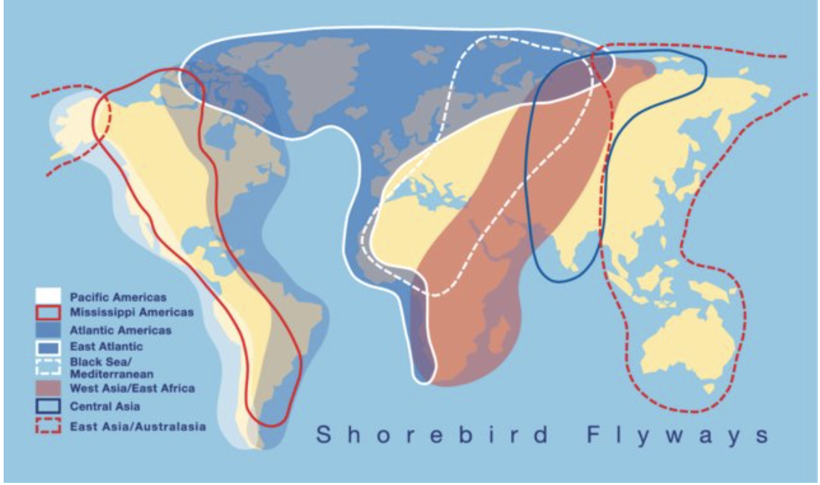
The Conference of the Birds
“Each pilgrim’s progress is commensurate
With his specific qualities and state
(No matter how it strives, what gnat could fly
As swiftly as the winds that scour the sky?).
Our pathways differ – no bird ever knows
The secret route by which another goes.
Our insight comes to us by different signs”

Slide 3
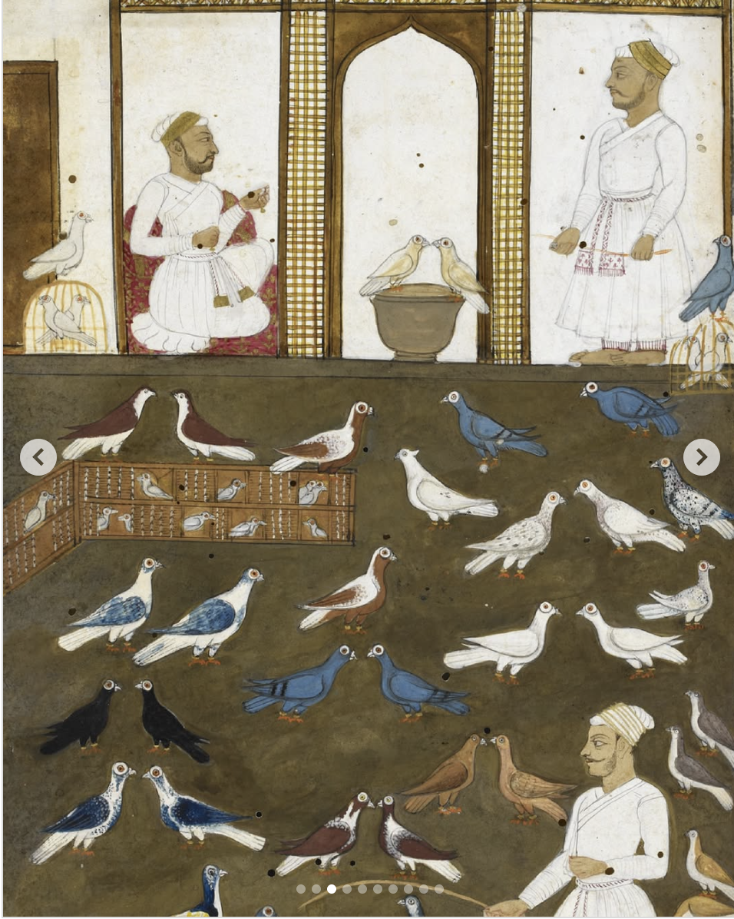
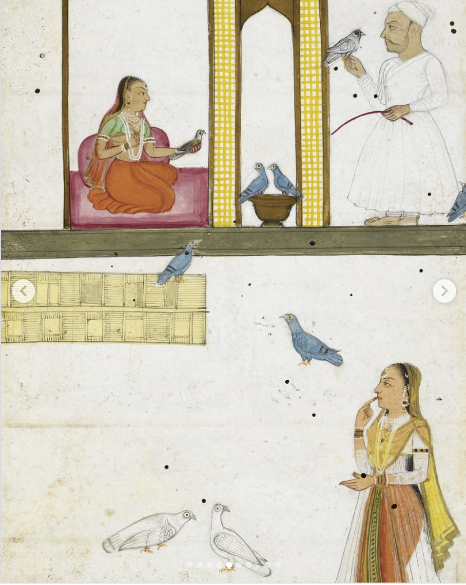
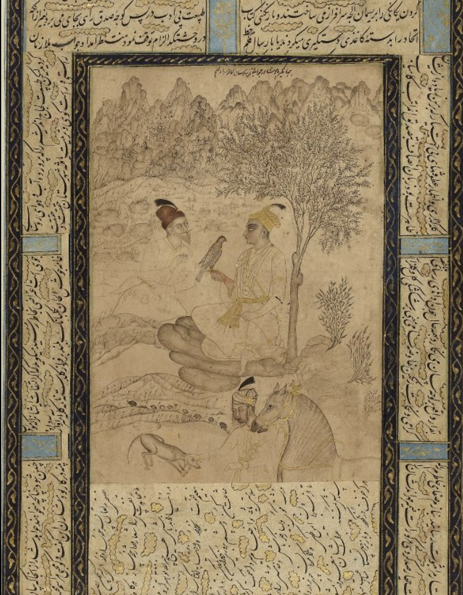
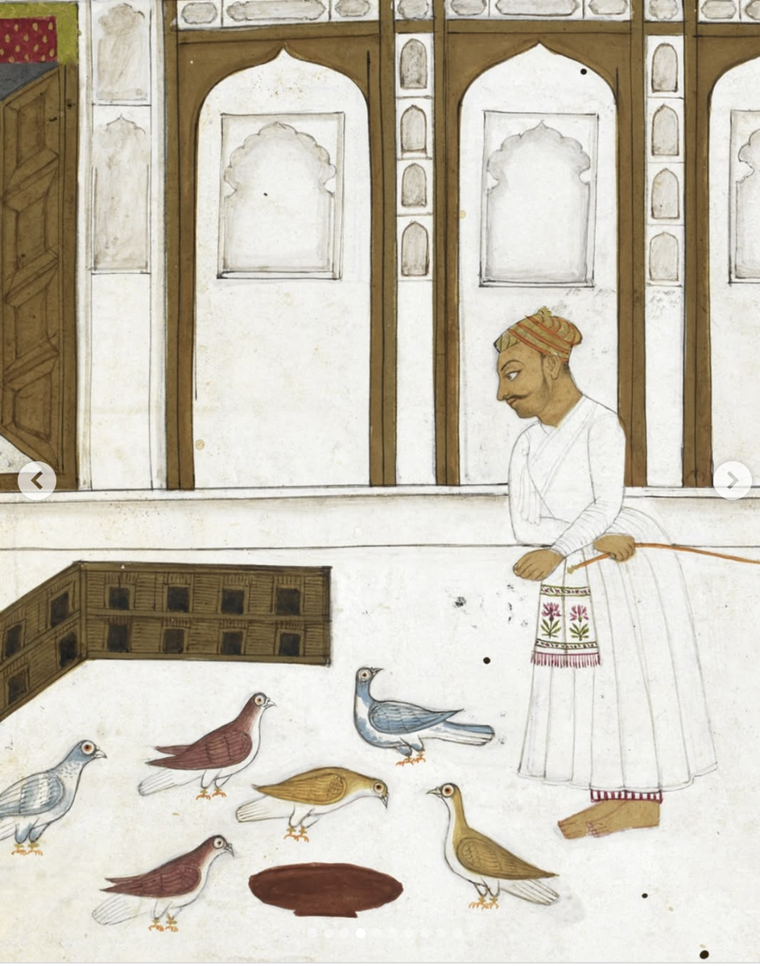
Learning from Birds in Mughal India
From the Akbarnama (1580s) to the Kabutarnama (1788)

Slide 4
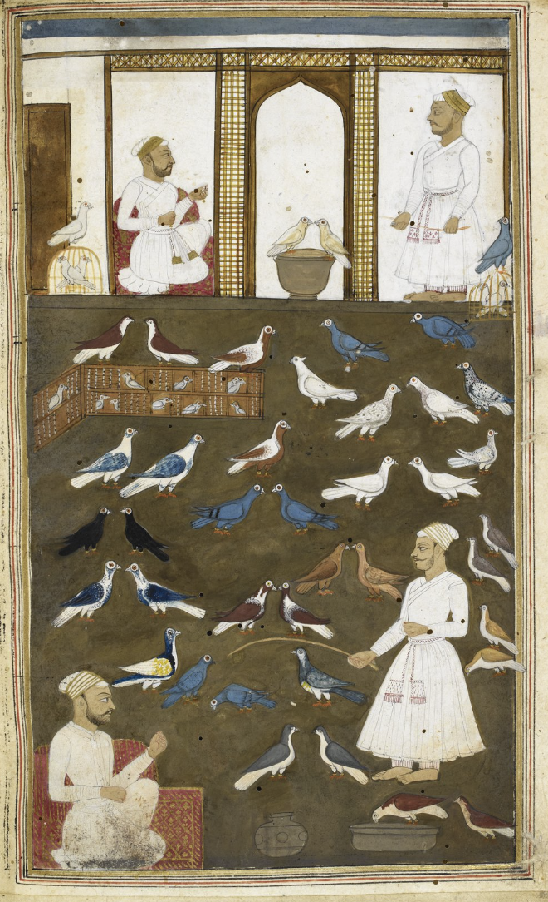
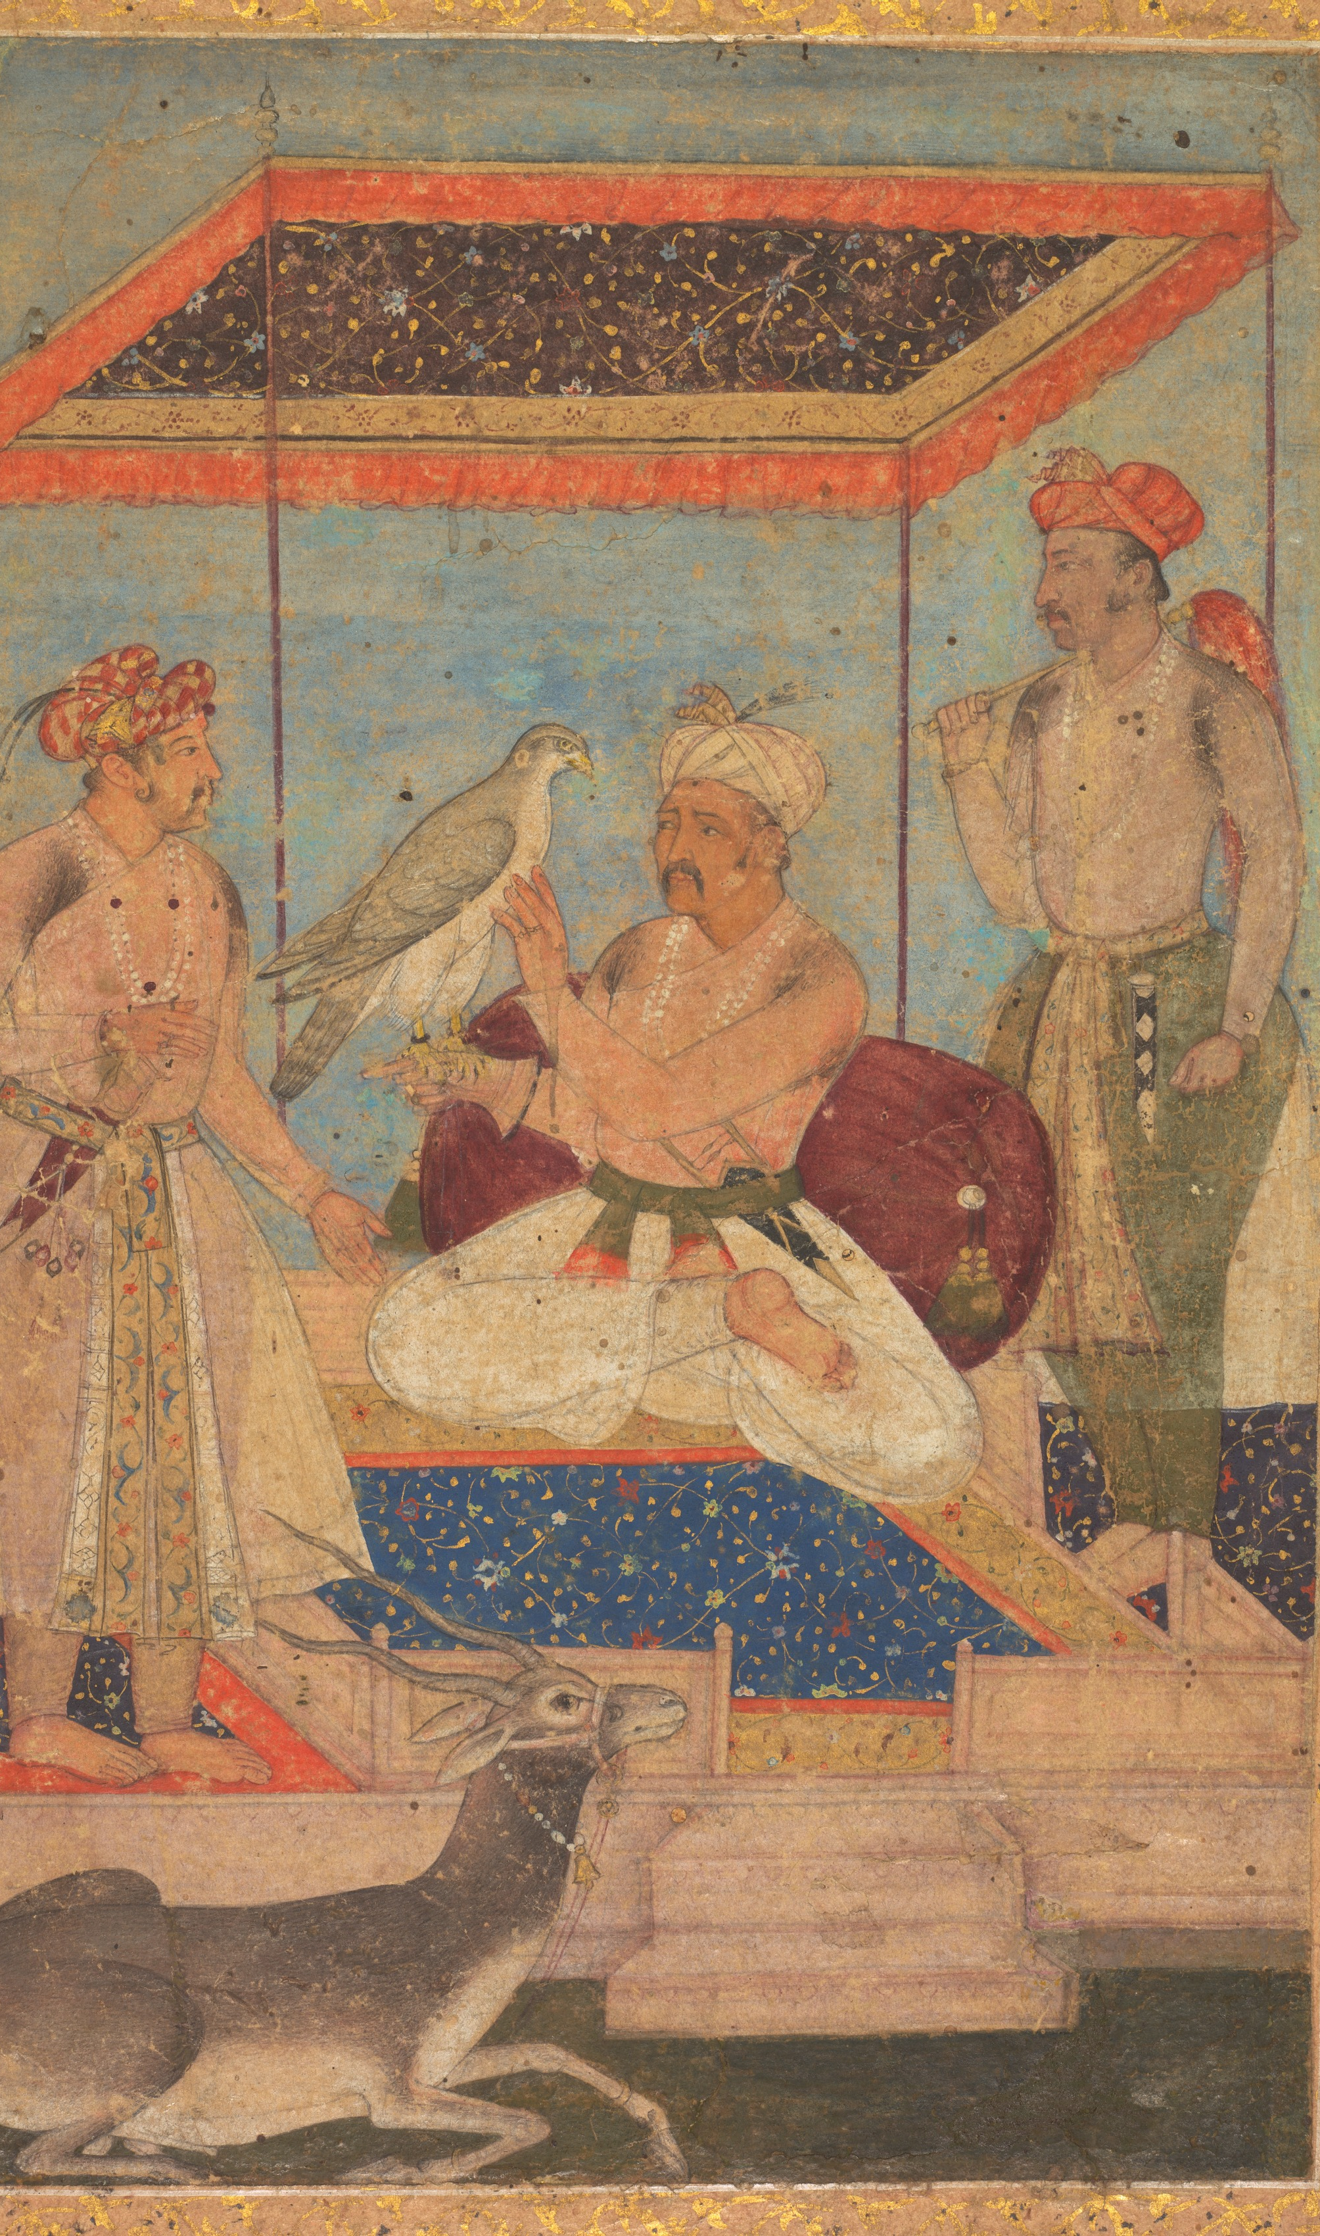
From the Akbarnama
Expresses his joy on receipt of the gift of pigeons, and a the arrival of young pigeon-fliers, particularly of a certain Habib whom he describes as a skilled and topmost pigeon-flyer from Transoxiana, well-versed in the knowledge of the minutest details about pigeons, so much so that he can even guess the height of a pigeon’s flight and its capacity to fly and play acrobatics long before the actual birther of that particular pigeon, or even before the yellow and white of the egg were mixed together. Further, stresses that Habib was like Galen, the physician, in the anatomy of pigeons, and a Plato in comprehension and perception of their skill. Excels in the knowledge of the breed, and the genealogy of diverse sections and different varieties of pigeons, and in this art even supersedes Naqib Khan – an expert in the genealogy of human beings.”

Slide 5
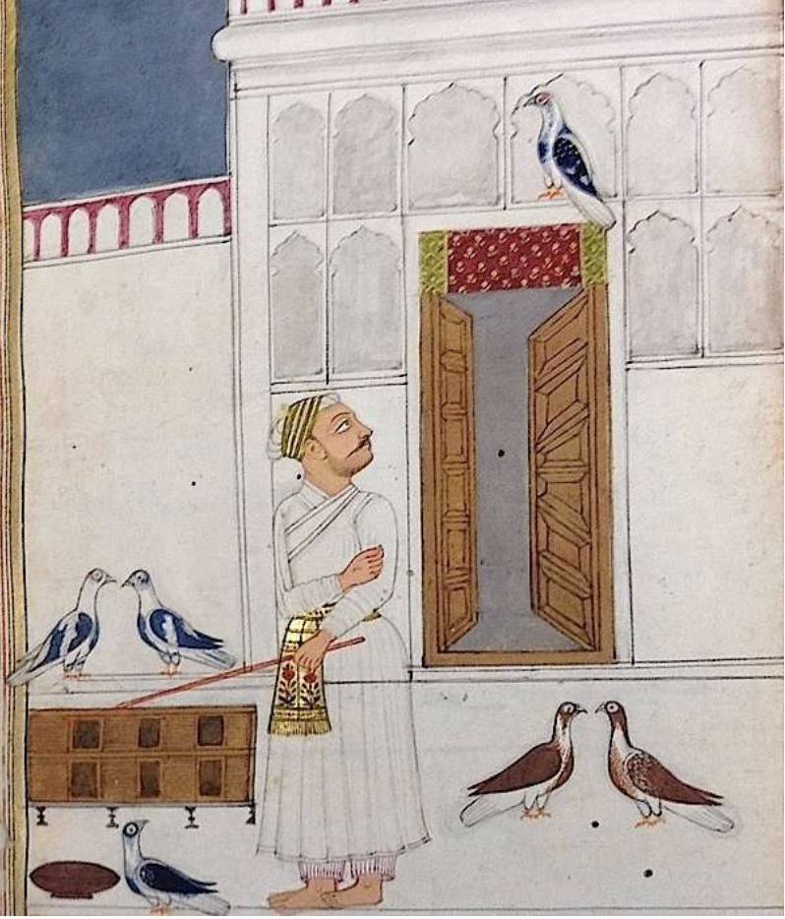
Pigeon Theory: The Power of Lightness and the Politics of Love
“The Kuttapar of Khurasan who was actually from Transoxiana was the leader of the trustworthy less feathered pigeons and flew high enough in the sky because
Whoever is light in weight soars conveniently
A light bird flies high and more quickly.”
“Although their entire life was spent in attracting others like sweethearts, the pigeons had themselves been ultimately drawn to the beloved sovereign”

Slide 7
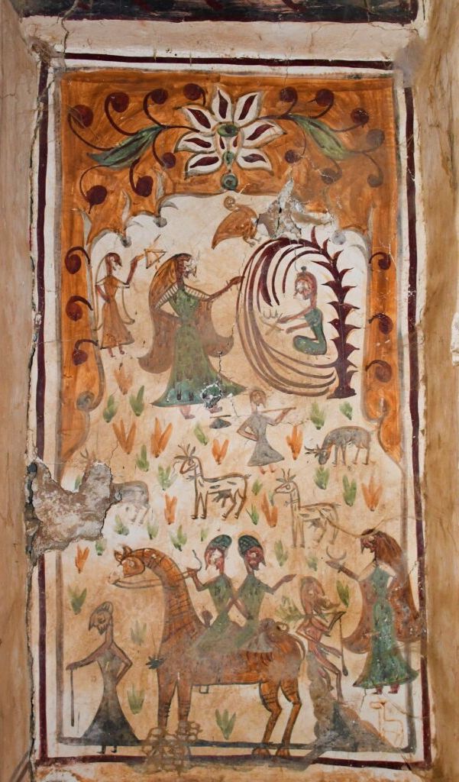
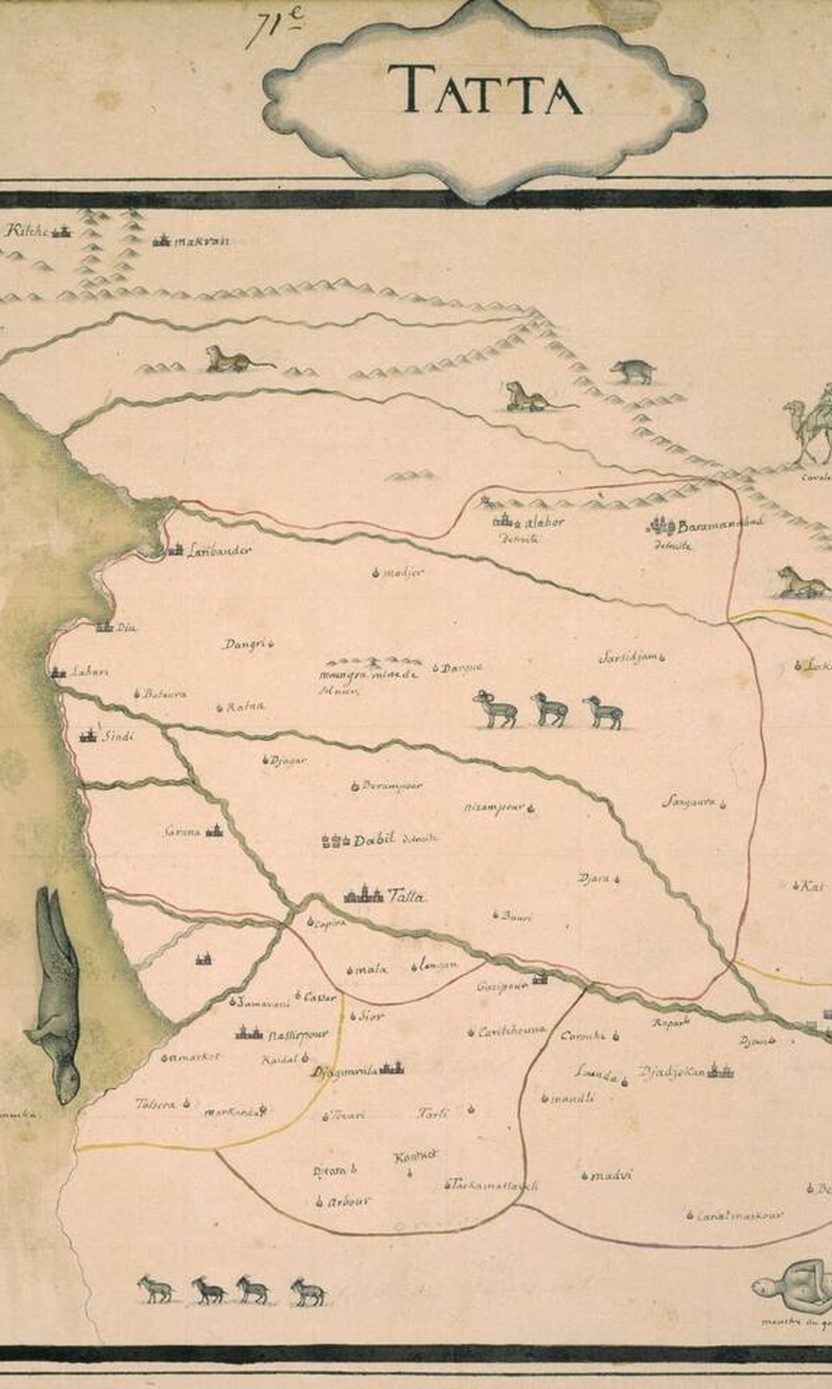
Mughal Sindh
From Kalhoro Rock Art to Jean-Baptiste Joseph Gentil (1770)

Slide 8
Bird Ontology
“Our pathways differ – no bird ever knows
The secret route by which another goes.
Our insight comes to us by different signs”
-Farid-ud-Din Attar, The Conference of the Birds

Slide 9
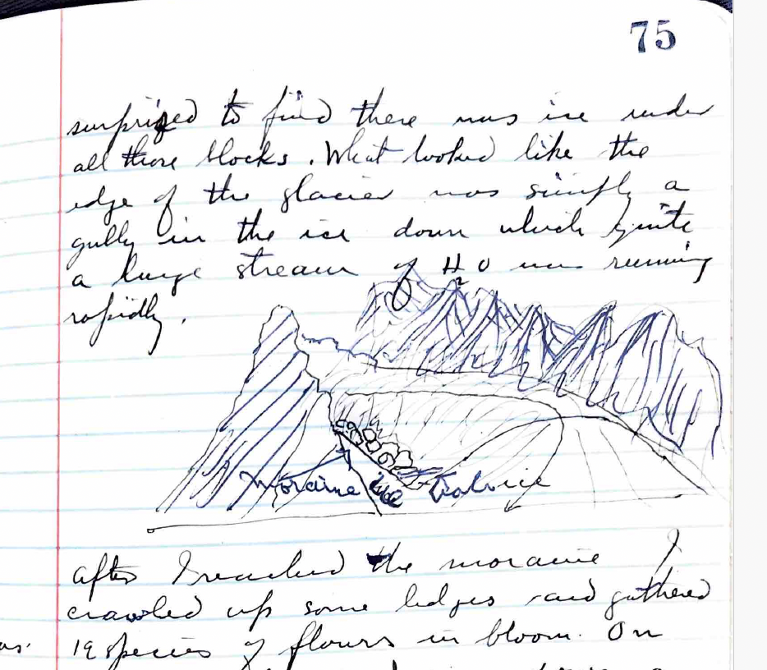
The Iceberg Breaks
“What looked like the edge of the glacier was simply a gully in the ice down which quite a large stream of H20 was running rapidly”

Slide 10
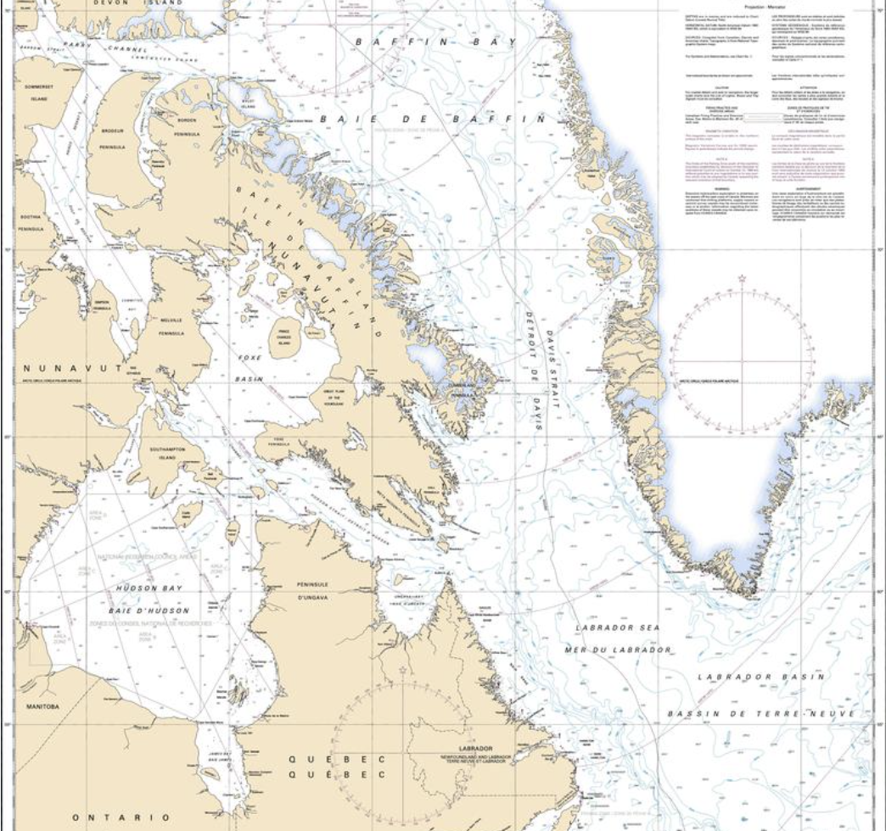
Birds and Maps
“Bird life is beginning to take on new forms.
“15 miles out by log we saw a Gt blue heron winging his way northward.”
“One bird under dispute I thought was crow others all seemed raven. If it was a raven was the first I ever saw wild.”
“The old birds were in evidence all the time flying over our heads and giving a shrill cry which we tried to interpret. The K-e – a of the books didn’t seem to fit it altogether. Capt Mae likened it to the meow of a cat if the sound could be made in one syllable. To my mind K-e-a with a r in it somewhere would be more like it. ..we had an opportunity to compare them with the rough legged hawk which was found on the next cliff. …Their cry was of about the same pitch but had a tremor in it not heard in the other. Both birds were seen & the two kinds bore no resemblance to each other. “
“I noted both white and black spruces round leafed drawn birch, glaucous willow, larch, red alpine campion, …The birches and mosses were wonderful in coloration…One must see these to appreciate the wonderful variety & know why it is possible for reindeer to make a living in the north. Their extent is limitless.”

Slide 11
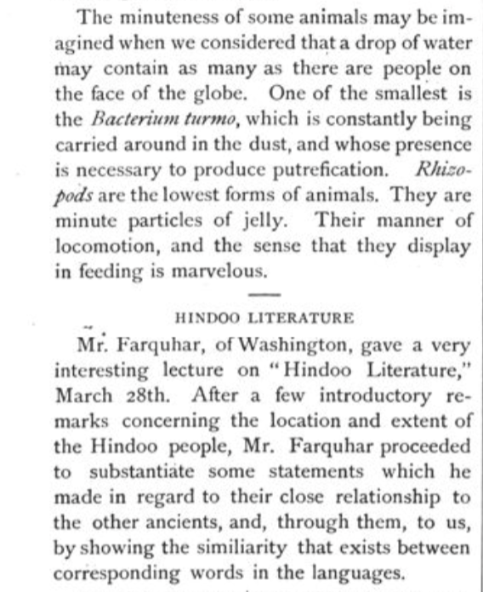
Swarthmore Phoenix (April 1, 1884)
A poem entitled “Spring Buds”: “And the north wind, hating your sweetness, in jealousy doth arise”
A lecture by Cyril Elder on war with England: “By official investigation, it has been found that in India thousands have died, owing to the want of work produced by Free Trade…She must have a penal reckoning for the wrongs she has committed under the plausible name of Free Trade. In the judgment that awaits her, she must compensate for the advantages that she has taken of weaker nations”
A lecture by Dr. Joseph Leidy entitled “A glance at the Lowest Forms of Life”. “The minuteness of some animals may be imagined when we considered that a drop of water may contain as many as there are people on the face of the globe.”
A lecture by Mr. Farquhar on “Hindoo Literature”

Slide 12
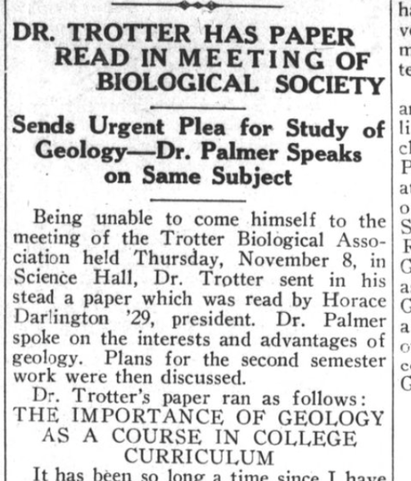
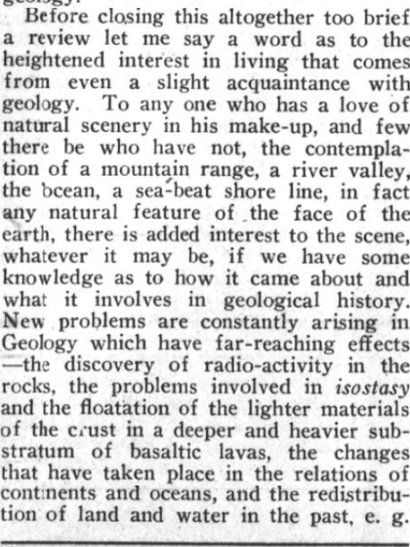
Dr. Trotter’s Case for Geology (November 13, 1928)
“Now I want to urge all Swarthmoreans to use their influence for the establishment of a Department of Geology, including the allied subjects of Minerology, Petrography. (Remember we have here at Swarthmore the fine Leidy Collection of minerals and the U.S. Geological Survey Educational Study Collection of Rocks) Climatology and Meteorology, Geography in its broadest aspects, as well as Plaeontology and all the branches of Geological Science. Do not let so great a subject be merely tacked-on to some other department. Swarthmore can become a great school for the study of Geology.”

Slide 13
