Slide 1
Welcome!
Networking 101
Lang Center Summer Grantees 2019

Slide 2
Agenda
4:30-5:00 | Eat Up!
5:00-5:30 | Intro Presentation
5:30-6:30 | Group Activity

Slide 3
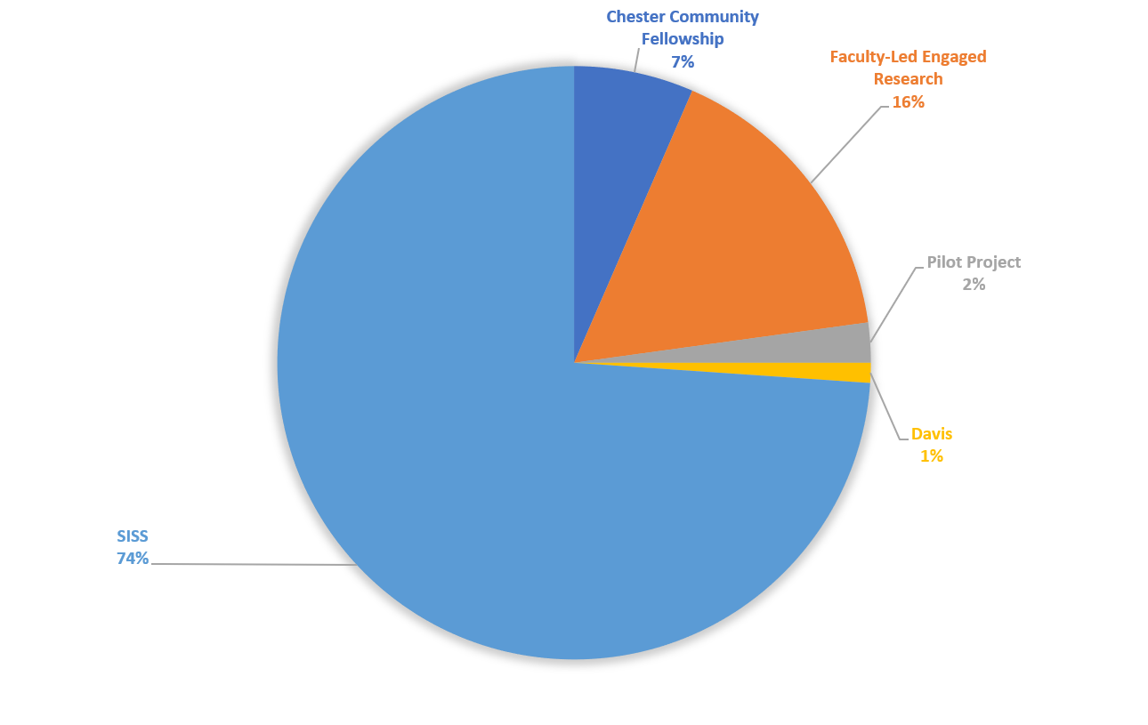
Award Types

Slide 4
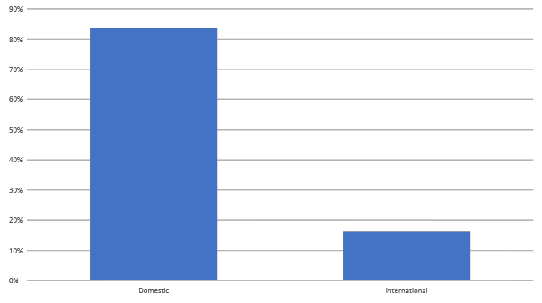
Award Locations

Slide 5
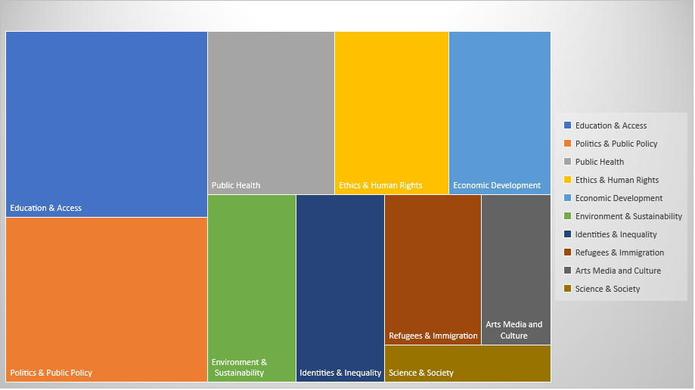
Issue Areas

Slide 6
Skill | Import Avg | Conf Avg | Total Score
Networking | 3.2 | 2.39 | 5.59
Building partnerships | 3.38 | 2.2 | 5.58
Measuring project outcomes | 3.08 | 2.49 | 5.57
Public presentation skills | 3.52 | 2 | 5.52
Professional writing | 3.34 | 2.11 | 5.45
Top 5 Skills Desired

Slide 7
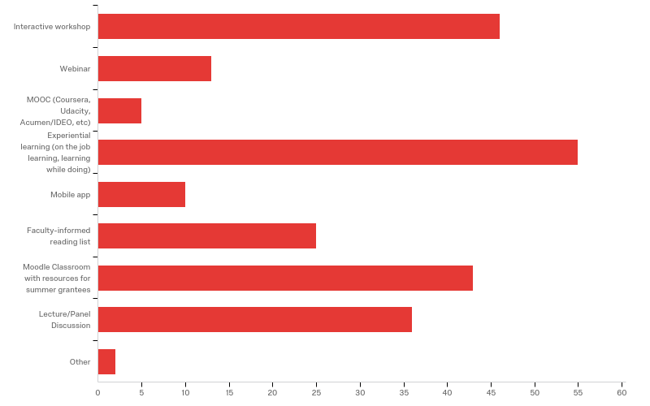
What is your preferred method of learning new skills?

Slide 8
Why network?
Gather and exchange information
Develop professional and social networks
Gain insight on prospective career path / goals

Slide 9
So, where does networking happen?
In Person
On campus
At work
Networking events
Conferences
Through Technology
Email
Phone calls
Personal website
LinkedIn / social media
Alumni Directory

Slide 10
Best Practices
for
Successful Networking

Slide 11
Creating Connections
Understand your educational/career story
  Where have you been
  How has your journey shaped you
  Where do you want to go?
Set a simple goal
  What do you hope to gain from conversations(s)?
Remember to follow-up
  If appropriate, propose plans for next conversation

Slide 12
When networking, DO:
Arrive on time dressed for the occasion
Use eye contact, handshake firmly
Bring up-to-date resume, business card
Ensure information on resume, LinkedIn, personal site consistent

Slide 13
Do not:
Chew gum, or use jargon, slang, etc.
Be afraid to ask questions OR dominate conversation
Speak to only one person
Forget how you aim to present yourself professionally!

Slide 14
Questions?
?

Slide 15
Activity: Networking Scenarios

Slide 16
Instructions
Form groups of 3, play out scenario
  2 actors (1 student, 1 potential connection)
  1 observer
  Each student should play each role once
Afterward, discuss:
  Did the student networker gain useful information or make a connection? How?
  What did the student networker do well?
  How could they improve next time?

Slide 17
1
At a local networking event you notice a hiring manager for an organization you’ve always dreamed of working for.
What do you say?

Slide 18
2
In the first week of your summer internship, you learn about a Swattie working in a high-level role in the organization. You work on the same floor, and hope to learn more about their path post-Swarthmore.
How do you initiate conversation?

Slide 19
3
One Friday evening while at dinner with colleagues, you notice someone who has just been hired by the organization post-graduation. You would like to know more about how they secured their job.
How do you approach them?

Slide 20
Final Challenge
Connect with 3 students working in your issue area.

Slide 21
Questions?
?

Slide 22
Thanks!

