Slide 1
Diffusion + Effusion
Ella Small

Slide 2

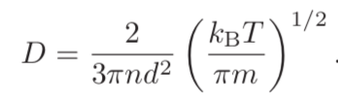
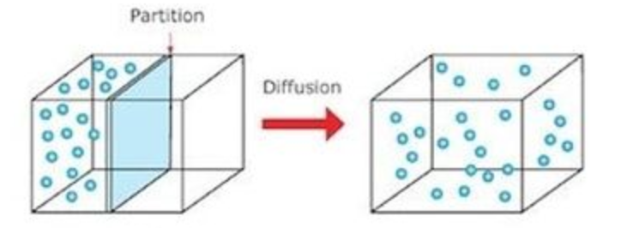

Diffusion
Net movement from a high concentration of particles to low concentration because of random motion of the particles
  Results in mixing without bulk motion
Governed by Fick’s first law:
  n* is the particle diffusing
  D is the diffusion coefficient:

Slide 3



Stokes Formula
In its essence, diffusion is just random fluctuations and collisions, where each collision makes the particle ‘forget’ what it was doing before
  But collisions mean friction!
  Say you have 1 collision per 𝚫t
  Define the viscous friction coefficient: and the drift velocity:
  All macromolecules, solutes, and even solutions are subject to these 2 equations
  Stokes formula gives us a way to measure the friction coefficient directly:
    R is the radius of the particle and η is the viscosity

Slide 4

Einstein Relation
Tells us that the fluctuations from the random walk are directly connected to the dissipation/frictional drag the particle is subject to.
Important because…
  It gives us a way to measure Boltzmann’s constant
  It’s also universal: giving the same value for kT no matter the situation

Slide 5

Examples in Geophysics
Erosion studies and other cases looking at earth’s surface
  Normally no actual diffusion happens here, but the process of diffusion accurately models the processes

Slide 6
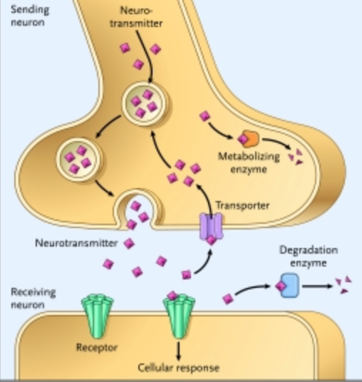
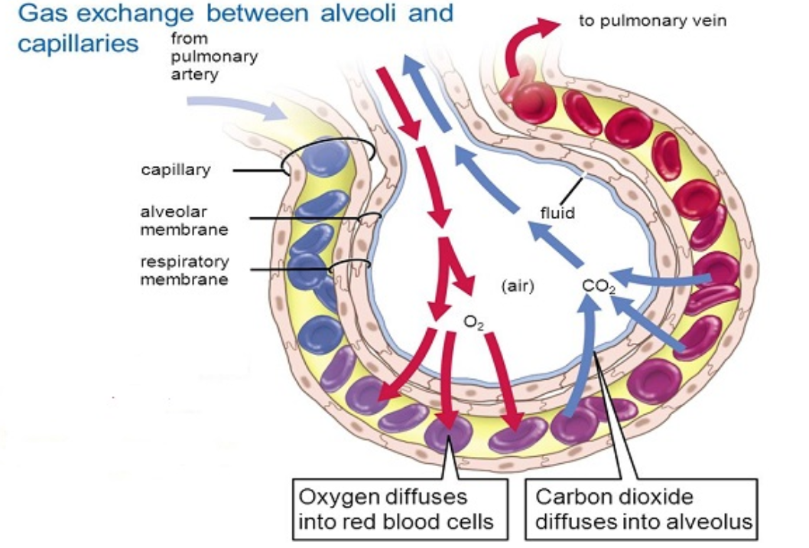
Examples in Biological Systems
Gas exchange
  Both at the alveoli in the lungs and at the tissues, putting oxygen into blood and taking CO₂ out
  Same in photosynthesis-exchanging gas in and out of the leaf
Transmission of neurotransmitters: how neurons communicate with one another
Osmosis
Diffusion doesn’t require extra energy from the cell

Slide 7
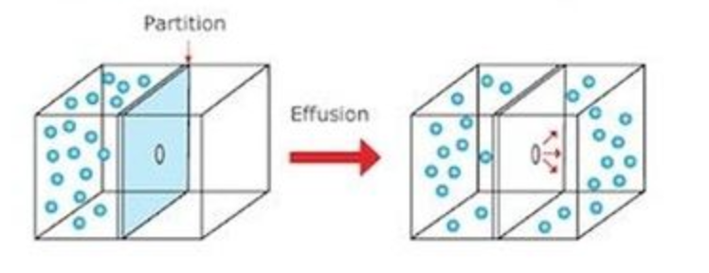
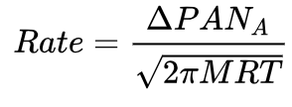
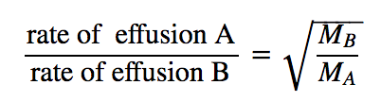
Effusion
Gas escaping from a small hole, where the hole is small enough to not disrupt the equilibrium of the gas
  Hole is significantly smaller than the mean free path of the particle
  So if a particle gets to the hole-it will likely pass through since it won’t collide with anything close by
Graham’s law of effusion
  Rate of effusion is inversely proportional to the square root of the mass of the molecule that’s effusing
  So balloons filled with helium die faster than those filled with oxygen

Slide 8
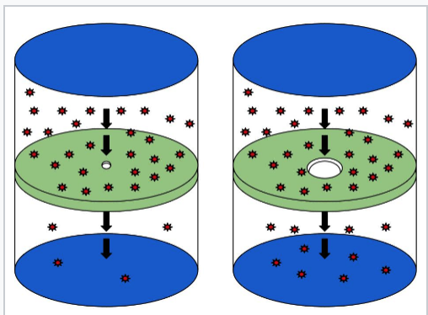
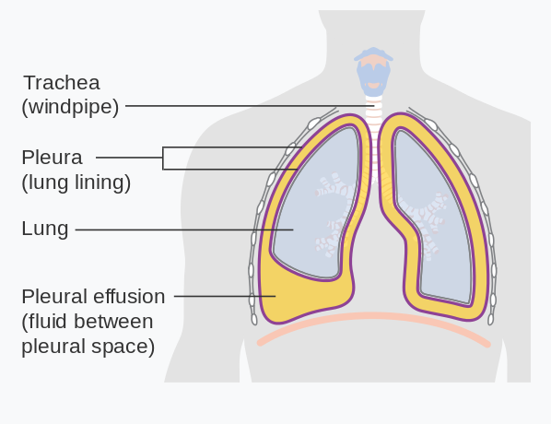
Lungs
Diffusion is good and helps us breathe!
Effusion causes collapsed lungs from capillaries with increased permeability
Effusion
Diffusion

Slide 9
Sources
Blundell, Stephen, and Katherine M. Blundell. Concepts in Thermal Physics. Oxford University Press, 2016.
“Diffusion.” Wikipedia, Wikimedia Foundation, 12 May 2018, en.wikipedia.org/wiki/Diffusion.
“Effusion.” Wikipedia, Wikimedia Foundation, 3 Apr. 2018, en.wikipedia.org/wiki/Effusion.
“Einstein Relation (Kinetic Theory).” Wikipedia, Wikimedia Foundation, 2 May 2018, en.wikipedia.org/wiki/Einstein_relation_(kinetic_theory).
Nelson, Philip. Biological Physics: Energy, Information, Life ; with New Art by David Goodsell. Freeman, 2014.
“Pleural Effusion.” Wikipedia, Wikimedia Foundation, 6 May 2018, en.wikipedia.org/wiki/Pleural_effusion.
Libretexts. “5.7: Effusion and Diffusion.” Chemistry LibreTexts, Libretexts, 21 July 2016, chem.libretexts.org/Textbook_Maps/General_Chemistry_Textbook_Maps/Map:_Chemistry_(Zumdahl_and_Decoste)/05:_Gases/5.07_Effusion_and_Diffusion.
IHW. “Movement Across Membranes .” Mar. 2005.

